Slide 1







EDGE ICT: R1D1 – Python (Django)
Module 1
Orientation & Introduction
Ziaur Rahman, PhD
Learning Management System (LMS):
21 Aug 2024, Tangail-1902
ICT 4103 – Simulation and Modeling
Department of Information and Communication Technology (ICT), MBSTU

Slide 2
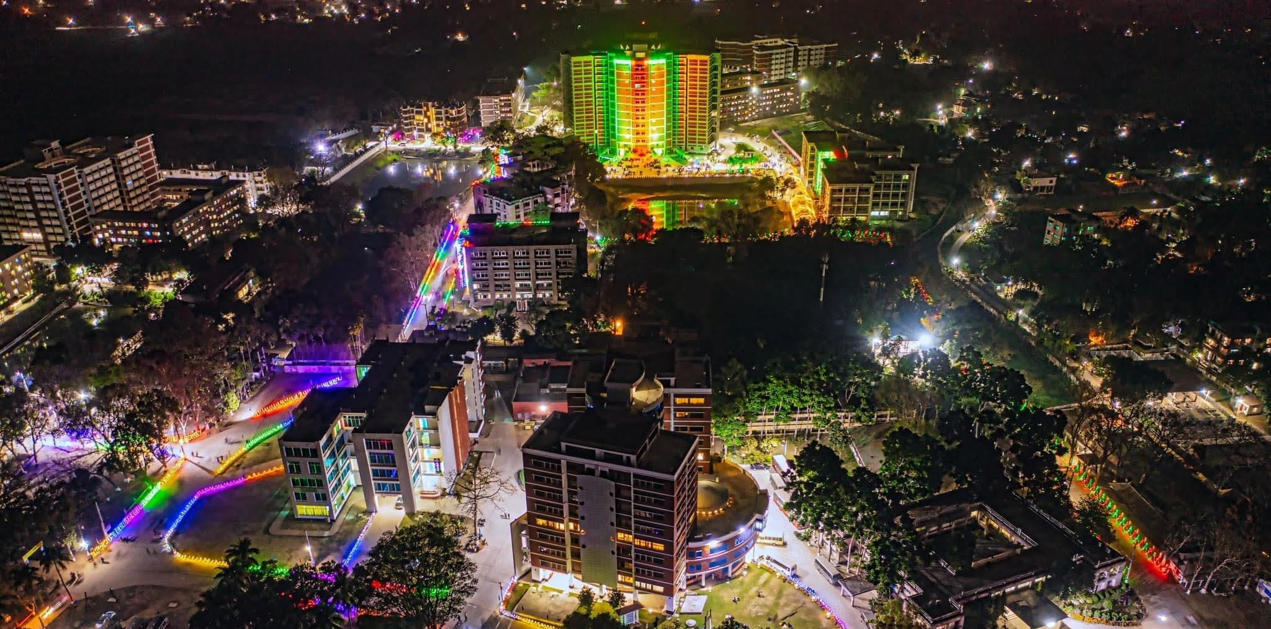
Course Outlines
Module 1: (1-2L)
Module 2: (3-6L)
Module 3: (7-10L)
Module 4: (11-14L)
Module 5: (15-18L)
Module 6: (19-21L)
Total = 27 (21 Internal + 6 External Lects.)

Slide 3
Course Outlines
Marks Distribution:
Class attendance: 10%
Quiz and Assignment(s): 20%
Mid-term assessment: 20%
Project: 25%
Final Evaluation: 25%
Total: 100%
Total = 27 (21 Internal + 6 External Lects.)

Slide 4


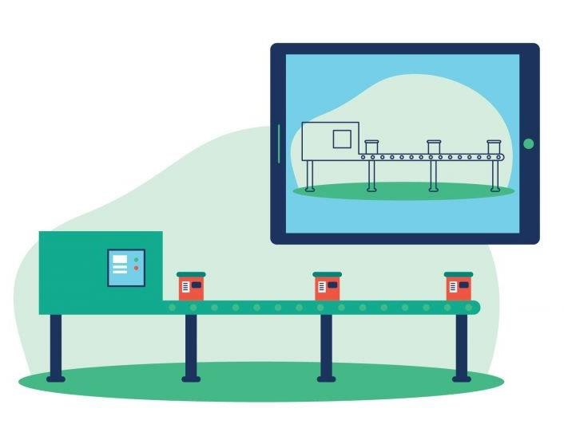

Introduction To Modeling and Simulation

Slide 5
1: Introduction To Modeling & Simulation
4
Modelling and Simulation Concepts
Definitions and What is Modelling and Simulation?
Types of Models
Advantages and Disadvantages of Simulation
Advantages of Using Models
Systems and System Environment
Components of a System
Discrete and Continuous Systems
Areas of Application
Modelling Procedure (Steps with Fig)

Slide 6
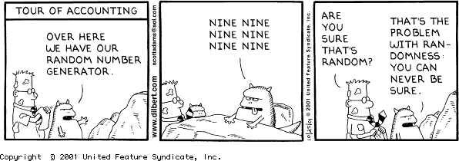
2: Random Number
5
Preliminaries: Modular Arithmatic Basics
Properties Of Random Numbers
Techniques For Generating Random Numbers
Linear Congruential Method

Slide 7
6
Credit: Tesla Digital Assets

Slide 8

TBC

Slide 9
QUESTION?
8

